Slide 1


Module6Unit1
Happy birthday.
★

Slide 2
let's sing a song
HAPPY BIRTHDAY
Happy birthday to you ,
Happy birthday to you ,
Happy birthday to you all ,
Happy birthday to you .

Slide 3
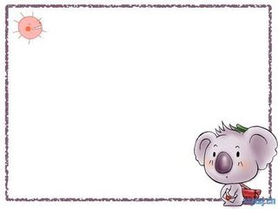
words
one two three four five six
seven eight nine ten eleven twelve
1
3
4
5
2
11
12
6
7
8
9
10

Slide 4

fourteen
eleven
11
12
twelve
17
13
14
thirteen
seventeen
15
16
sixteen
fifteen

Slide 5

words
happy birthday here present
this pencil pen cake
old how old yes
you're =you are
PPT模板：www.1ppt.com/moban/ PPT素材：www.1ppt.com/sucai/
PPT背景：www.1ppt.com/beijing/ PPT图表：www.1ppt.com/tubiao/
PPT下载：www.1ppt.com/xiazai/ PPT教程： www.1ppt.com/powerpoint/
资料下载：www.1ppt.com/ziliao/ 范文下载：www.1ppt.com/fanwen/
试卷下载：www.1ppt.com/shiti/ 教案下载：www.1ppt.com/jiaoan/
PPT论坛：www.1ppt.cn PPT课件：www.1ppt.com/kejian/
语文课件：www.1ppt.com/kejian/yuwen/ 数学课件：www.1ppt.com/kejian/shuxue/
英语课件：www.1ppt.com/kejian/yingyu/ 美术课件：www.1ppt.com/kejian/meishu/
科学课件：www.1ppt.com/kejian/kexue/ 物理课件：www.1ppt.com/kejian/wuli/
化学课件：www.1ppt.com/kejian/huaxue/ 生物课件：www.1ppt.com/kejian/shengwu/
地理课件：www.1ppt.com/kejian/dili/ 历史课件：www.1ppt.com/kejian/lishi/
Notes:
PPT模板：www.1ppt.com/moban/ PPT素材：www.1ppt.com/sucai/
PPT背景：www.1ppt.com/beijing/ PPT图表：www.1ppt.com/tubiao/
PPT下载：www.1ppt.com/xiazai/ PPT教程： www.1ppt.com/powerpoint/
资料下载：www.1ppt.com/ziliao/ 范文下载：www.1ppt.com/fanwen/
试卷下载：www.1ppt.com/shiti/ 教案下载：www.1ppt.com/jiaoan/
PPT论坛：www.1ppt.cn PPT课件：www.1ppt.com/kejian/
语文课件：www.1ppt.com/kejian/yuwen/ 数学课件：www.1ppt.com/kejian/shuxue/
英语课件：www.1ppt.com/kejian/yingyu/ 美术课件：www.1ppt.com/kejian/meishu/
科学课件：www.1ppt.com/kejian/kexue/ 物理课件：www.1ppt.com/kejian/wuli/
化学课件：www.1ppt.com/kejian/huaxue/ 生物课件：www.1ppt.com/kejian/shengwu/
地理课件：www.1ppt.com/kejian/dili/ 历史课件：www.1ppt.com/kejian/lishi/

Slide 6









Guess猜一猜
What's this?
window

Slide 7
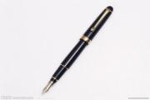
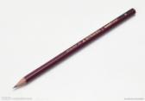
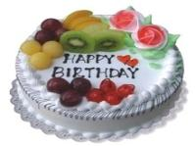
What's this?
It's a pen.
It's a pencil.
?
It's a cake.

Slide 8
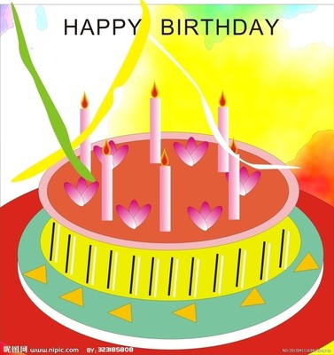
cake
It's a cake.

Slide 9

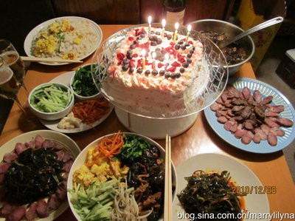
birthday
生日

Slide 10


happy
快乐
I’m happy.
▼
◆

Slide 11

let's sing
Happy birthday to you.

Slide 12


Here's your present.
Here's your cake.

Slide 13
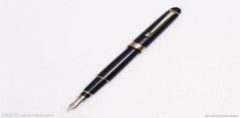
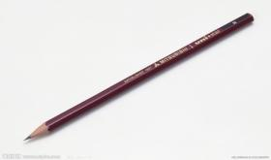
Here's your pen.
↓
here's=here is
(这里是) （这里）
---Here's your pencil.
---Thank you.

Slide 14
LISTEN AND ANSWER
How old is Sam ?
He is nine.

Slide 15


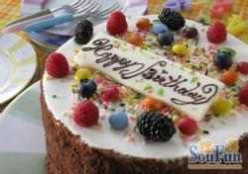
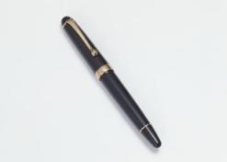


Here's your present .
cake
pen
pencil
cap

Slide 16

How old are you ?
I'm nine.
dragon game

Slide 17
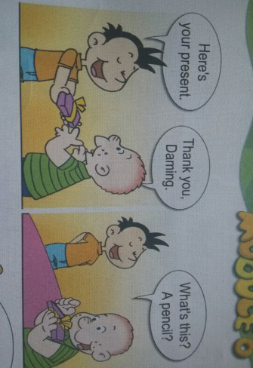
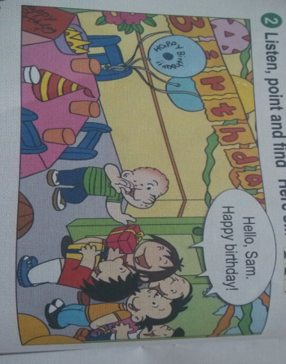
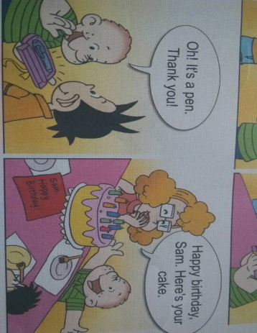
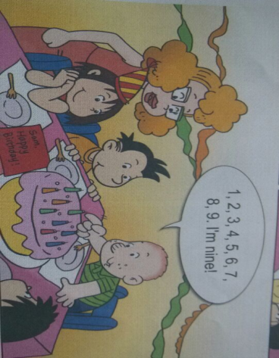

Slide 18
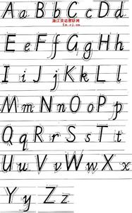

Slide 19
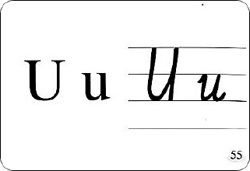
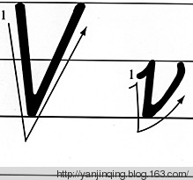

Slide 20
Homework
1. Make a birthday card.
Write some prays in English.
(为即将过生日的朋友或家人制作一份英文版生日贺卡。)
2. Review the new words and the drills.
（复习本课学过的新词和句式。）

Slide 21
Thank you！

